Slide 1
CMIP6/IPCC-AR6 UPDATE
Simon Marsland | CSIRO Climate Science Centre

Slide 2
WGCM-22/CMIP-6 – Barcelona March 25-29
Working Group on Coupled Modelling 22 slides
https://www.wcrp-climate.org/sessions/1466-wgcm-22-agenda
CMIP6 Workshop slides
https://cmip6workshop19.sciencesconf.org/resource/page/id/15

Slide 3

CMIP6 Equilibrium Climate Sensitivity
Courtesy V. Eyring, C. Tebaldi
https://science.sciencemag.org/content/364/6437/222.full

Slide 4
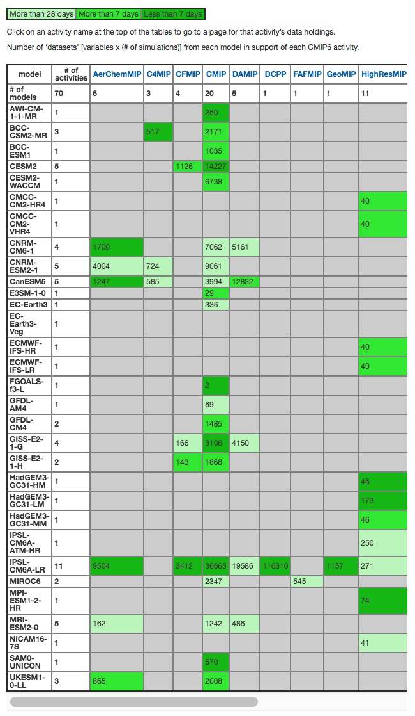
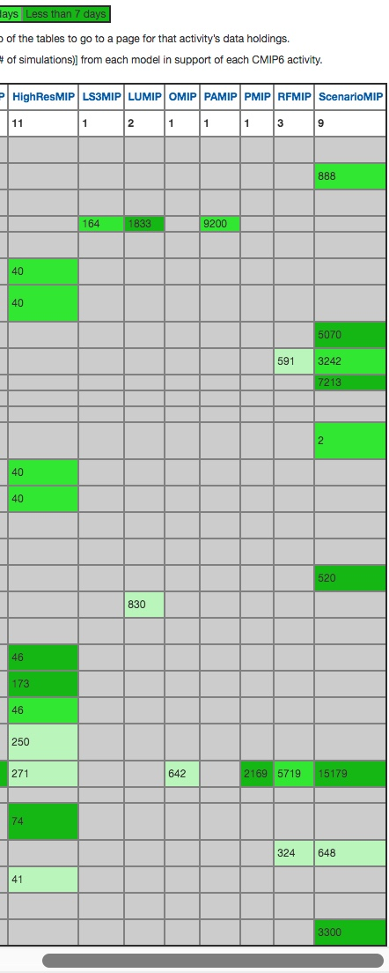
PCMDI ESGF CMIP6 Data Holdings
https://pcmdi.llnl.gov/CMIP6/ArchiveStatistics/esgf_data_holdings/

Slide 5
IPCC-AR6 First Order Draft Expert Review
https://apps.ipcc.ch/comments/ar6wg1/fod/register.php
29 Apr 2019 to 23 Jun 2019.
Registration open until 2019-06-15 23:59(CST).

Slide 6


IPCC Deadlines: 31 Dec 2019 literature subm. https://wg1.ipcc.ch/AR6/AR6.html

Slide 7
CMIP7
Science direction for next several years is set by the ingoing CMIP6 and 21 MIPs, and their analysis
https://www.wcrp-climate.org/modelling-wgcm-mip-catalogue/modelling-wgcm-cmip6-endorsed-mips
Update horizon for forcings – critical failures
WCRP Strategic Plan 2019-2029
https://www.wcrp-climate.org/wcrp-sp

